Slide 1
Data Analysis for Real Estate Investment using Zillow Data:
Buy to Sell or Buy to Rent?
Haseeb Durrani

Slide 2
Outline
Buy to Sell or Buy to Rent?
Data Source
Exploratory Data Analysis
Shiny App Demonstration
Future Work

Slide 3
Buy to Sell or Buy to Rent?
Real Estate Investment
Why do we care?
Rent to Value Percentage

Slide 4
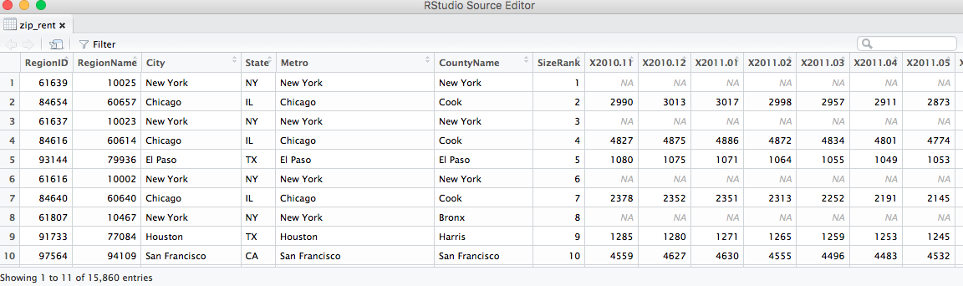
Data Source
Zillow Data
78.1 M Single Family Zestimates
Zestimate

Slide 5
Exploratory Data Analysis

Slide 6
Some more EDA
Low Value + Greatest Percent Increase in Value:
"ID" "NV" "FL”
High Rent + Greatest Percent Increase in Rent:
"FL" "MA" "CA" "TX" "WA" "NH”
High Rent + Greatest Percent Increase in Rent and Value + Low Value
"FL" "NC" "ID" "ND" "NE" "NV”
High Rent + Low Value
"FL" "NC"

Slide 7
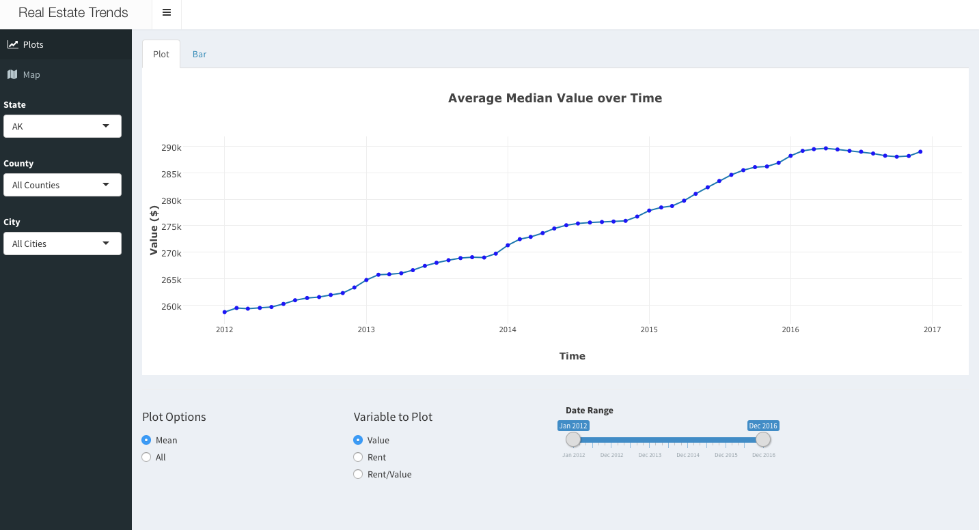

Slide 8
Future Work
More Data
Predictive Data Analysis

Slide 9
Thank you for your time Any Questions?

